Slide 1

SIPNA COLLEGE OF ENGINEERING AND TECHNOLOGY
AMRAVATI
Project Loon
The Balloon-Powered Internet
Presented By : Manish Dhaye
Guided By : Prof. Neha G. Rathi

Slide 2
Contents :
Introduction
History
Structure of Balloon
Working of Project Loon
Advantages and Challenges
Conclusion
References

Slide 3
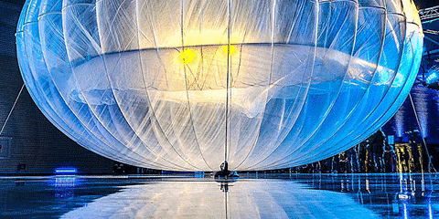
Introduction :
Project Loon - network of balloons in stratosphere - connect people in rural areas .
Developed By : Alphabet.Inc ( Google’s Parent Company )
A Loon balloon at the Christchurch launch event in June 2013
Goal : To create a global internet network by providing reliable & affordable
connectivity to billions of individuals who were previously disconnected.
Project Loon was temporarily discontinued in 2021 due to the cost per area issue
but still research and development is going on to make it more cheaper .

Slide 4
History :
On 14th June 2013, Google announced Loon as an official project .
On 16th June 2013, A pilot Experiment happened in New Zealand and about
30 balloons were launched .
On 6th October 2017, An emergency LTE coverage was provided to
Puerto Rico in the aftermath of Hurricane Maria .
On 21th January 2021, Alphabet announced that Loon would be temporarily Discontinued.

Slide 5
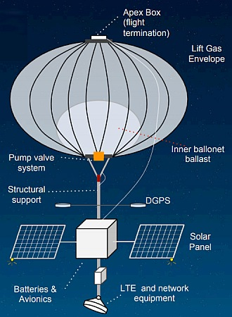
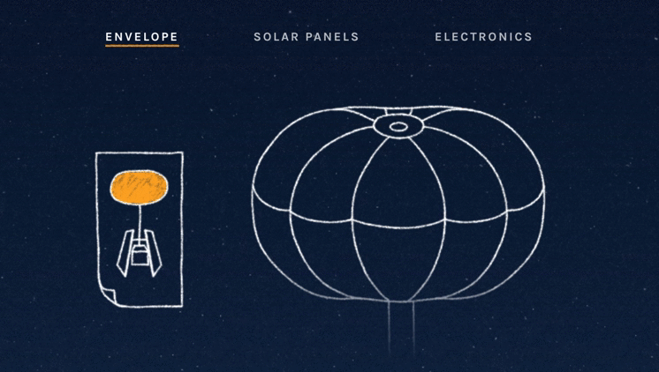
Structure Of Balloon :

Slide 6
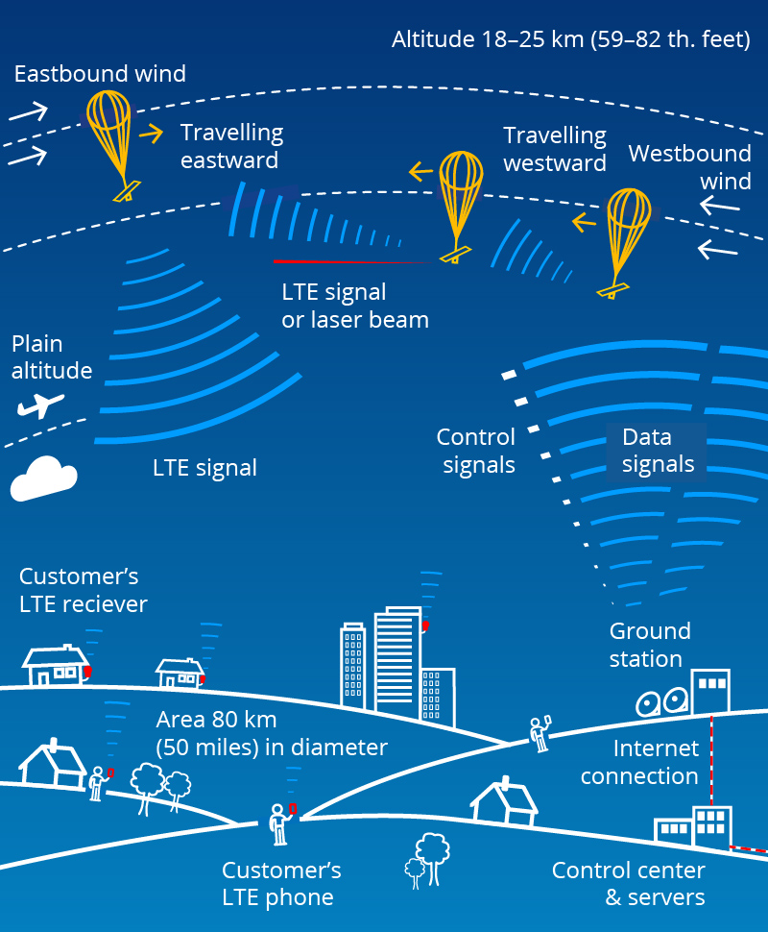
Working Of Project Loon :
Control Center & Server
Ground Station
Network Of Balloons
Customer’s
LTE Receiver
Internet Connection
Data Signals
LTE Signal
Customer’s
LTE Phone

Slide 7
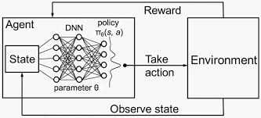
How AI used in Project Loon :
Utilized Deep Reinforcement Learning (DRL) - navigation of stratospheric balloons
Deep Reinforcement Learning (DRL) = Reinforcement Learning + Deep Learning

Slide 8
Advantages :
Challenges :
Flexible
Global coverage
Rapid deployment
High Costs
Wind unpredictability
Commercial viability

Slide 9
Conclusion :
Project Loon continues its research and development phase, its future remains promising.
The technology has proven its potential but faced hurdles that need to be addressed for broader implementation .
Continued research and experimentation will be essential to fulfill its goal of providing global internet coverage .

Slide 10
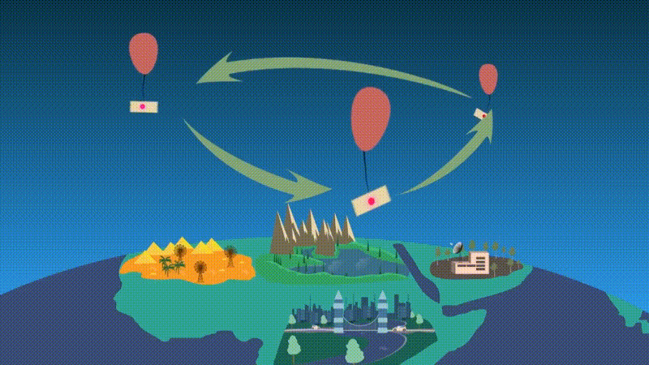

Slide 11
References :
[1] N. V. Kadam, A. G. Kadu, and S. S. Dhok, "Internet Through Balloons – A Study,
" Volume 7, Issue 2,February-2016 ISSN 2229-5518
[2] Google Project Loon, https://x.company/projects/loon/
[3] Google Project Loon, YouTube
[4] Loon LLC, Wikipedia, https://en.wikipedia.org/wiki/Loon_LLC

Slide 12
Thank You

